Slide 1
Machine Learning Workflows Marius Danciu

Slide 2
Intro
What does it mean to train/learn ?
How do we know that we got a good enough model ?
How do we operationalize models ?
What next ? … learn some more.

Slide 3

Training

Slide 4
Algorithms
Supervised learning
Regression – Linear regression, Decision Trees
Classification
Logistic regression
Decision trees/ Random forests
Naïve-Bayes,
SVM
(Deep) - Neural-Networks
CNN
ResNet
AlexNets
Un-supervised learning
Clustering : k-means, k-NN
Associations: Apriori
Dimensionality reduction: PCA
Ensembles
Boosting, Bagging
Recommender systems
Content based, Collaborative filtering
Anomaly detection
Gaussian distribution, KNN, LOF, OneClassSVM
Reinforcement learning
A/B testing, Multi-armed bandits

Slide 5
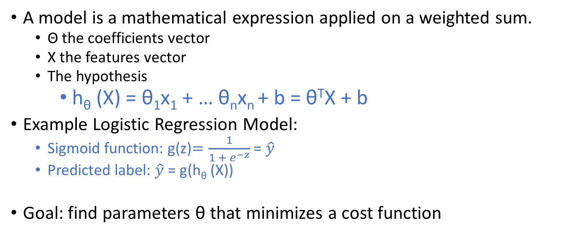
Models
A model is a mathematical expression applied on a weighted sum.
Θ the coefficients vector
X the features vector
The hypothesis
h_{θ} (X) = θ₁x₁ + … θ_{n}x_{n} + b = θ^{T}X + b
Example Logistic Regression Model:
Sigmoid function: g(z)$=\frac{1}{1 + e^{−z}}$ = $\hat{y}$
Predicted label: $\hat{y}$ = g(h_{θ} (X))
Goal: find parameters θ that minimizes a cost function

Slide 6

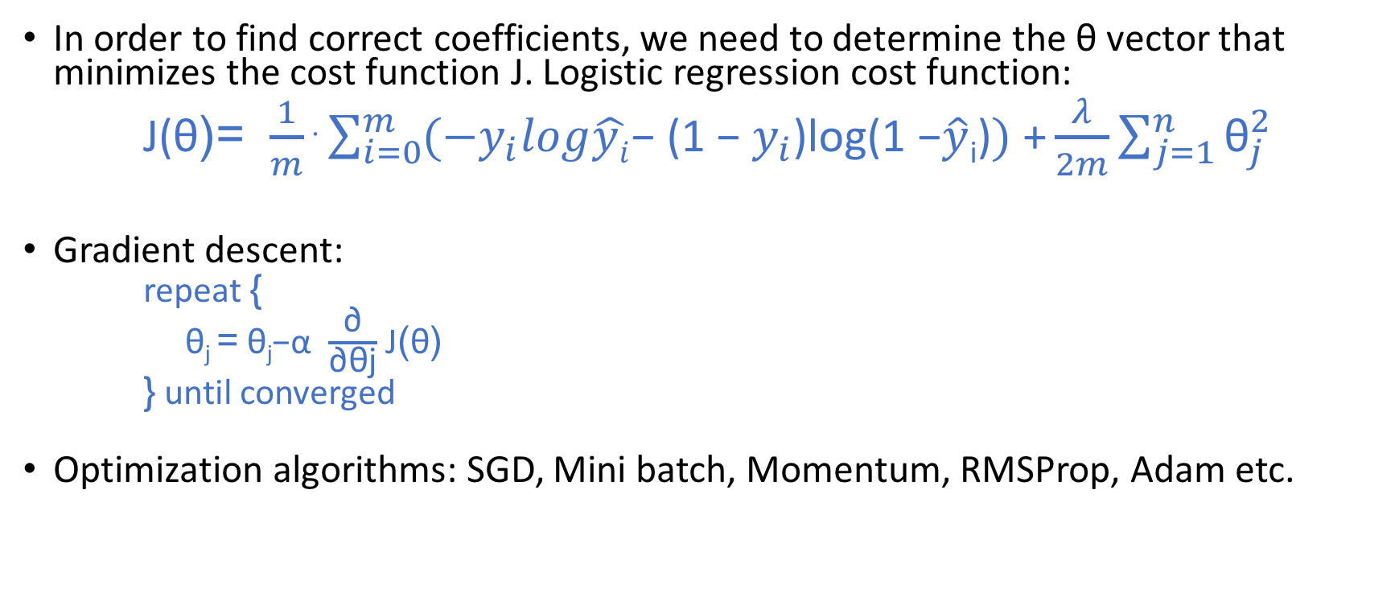
Training is an optimization problem
In order to find correct coefficients, we need to determine the θ vector that minimizes the cost function J. Logistic regression cost function:
J(θ)= $\frac{1}{m}$⋅$\sum_{i=0}^{m}{(−y_{i}log\hat{yi}\text{− (1 − }y_{i}\text{)}\text{log}\text{(1 −}\hat{y}\text{i}\text{)}})\text{ +}\frac{λ}{2m}\sum_{j=1}^{n}{{\text{θ}}_{j}^{2}}$
Gradient descent:
repeat {
θ_{j} = θ_{j}−α $\frac{\text{∂}}{\text{∂}\text{θj}}$ J(θ)
} until converged
Optimization algorithms: SGD, Mini batch, Momentum, RMSProp, Adam etc.

Slide 7
Pipelines
Models are difficult to manage
Training a pipeline :
fit: Data => Pipeline-Model
Score Pipeline-Models not models
transform: Data => Data
T1
T2
T3
LR
Pipeline
fit
T1
T2
T3
LRM
Pipeline-Model

Slide 8
Frameworks/libraries
ML
Scikit-learn
SparkML – mllib
Xgboost
LightGBM
DL
TensorFlow
Caffe
PyTorch
H2O
MxNet
DL4j

Slide 9
Model Evaluation

Slide 10
Models performance
Different model types lead to different measures
Regression: RMSE
Classification: Precision, Recall, F1-Score, AuROC

Slide 11
Overfitting / bias
Overfitting – the model gets great accuracy on training data but it’s really bad on test data.
Regularization – L1, L2, Dropouts, Data Augmentation
Bias – the model is bad on both training and test data
Learning curves

Slide 12
Experiments
During a machine-learning project there are many unknowns
How to shape data ?
What features are relevant ?
Need data augmentation ?
What algorithms to choose ?
What hyper-parameters to choose ?
Learning
Hyper-Parameter-Optimization
Grid Search
Random Search
Bayesian Optimization
…

Slide 13
IBM Watson Studio Experiment

Slide 14
Models deployment

Slide 15
Operationalize models
Models as service
Provide REST / gRPC endpoints for scoring
Containerization : Docker + Kubernetes
Dynamic scaling
Models as Docker images
Models as industry formats/standards: Core-ML, ONNX, PFA, PMML

Slide 16
Learn again … and again
Collect feedback data (labeled data / data with ground truths)
Retrain
Full retrain
Incremental models
Transfer learning
Evaluate
Deploy

Slide 17
Workflow
cleanse pipeline
feature engineering
data sources
analyze
iterate
experiment
model definition
model fitting
train
model evaluation
hyper
parameters
candidate model
iterate
deploy
monitor
feedback

Slide 18




Watson Studio
Built for AI teams – enabling team productivity and collaboration
Domain Expert
Data Scientist
Data Engineer
The Developer
Her Job:
To transfer knowledge to Watson for a successful user experience.
His Job:
Transform data into knowledge for solving business problems.
His Job:
Architects how data is organized and ensures operability
Her Job:
Builds AI application that meet the requirements of the business.
What she does:
Range of domain knowledge and uses that to teach Watson and develop a custom models
As Tanya gains more experience she optimizes her knowledge to teach Watson to design better end-user experiences.
What he does:
Runs experiments to build custom models that solve business problems.
Use techniques such as Machine Learning or Deep Learning and works with Tanya to validate success of trained models.
What he does:
Builds data infrastructure and ETL pipelines. Works with Spark, Hadoop, and HDFS.
Works with data scientist to transform research models into production quality systems.
What she does:
Starts PoCs which includes gathering content, dialog building and model training
Focus is on app building for the team or company to use. Will handle ML Ops as needed
Sometimes known as:
Subject matter expert, content strategist.
Sometimes known as:
ML/DL engineer, Modeler, Data Miner
Sometimes known as:
Data infrastructure engineer
Sometimes known as:
Front-end, back-end, full stack, mobile or low-code developer

Slide 19
References
https://dataplatform.ibm.com/
https://www.ibm.com/cloud/machine-learning

